Slide 1
Presentation 1

Slide 2
Equities Database
By: Alfred Timperley, Quinn Smith, Bennet Lou
Notes:
Alfred

Slide 3
Project Idea
Create a database that stores all relevant information about equities
Stores information like:
Shareholders for a stock
What exchange the stock is listed on
What indexes is the stock apart of
What sector the stock is in
Create a UI to be able to easily add / remove / update the database
Create an application to visualize the prices
If time allows create an application to ‘paper trade’ on the market
Notes:
Quinn

Slide 4
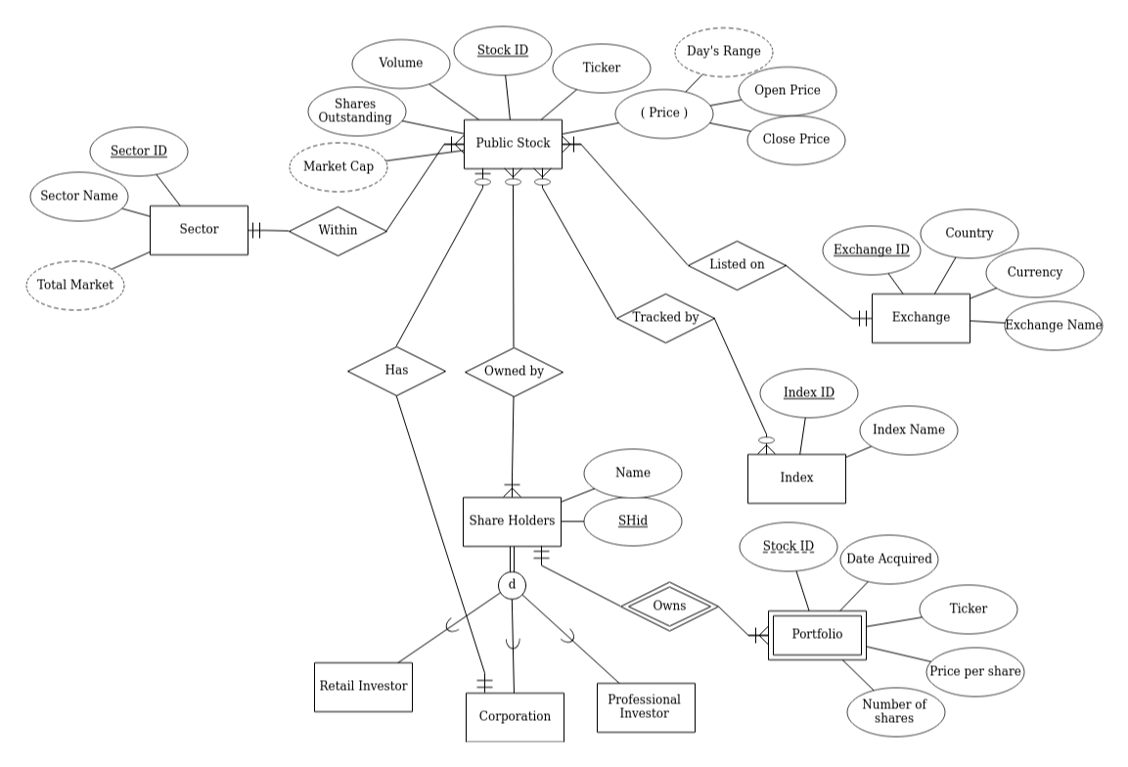
Initial E-R Diagram
Notes:
Alfred

Slide 5
Data Sources
yfinance
A python library that scraps data off of the yahoo finance website
Contains historical stock data
Pricing data
Volume
Dividends
Major Shareholders
Balance Sheets
Financials
Nasdaq stock screener
Can get .csv of stocks listed on nasdaq, nyse, and amex
Stocks tracked by Indexes are publicly available
Notes:
Quinn

Slide 6
High Level Operations
Stocks
Add a stock to the database
Update a stock or a stock attributes in database
Remove a stock from the database
Shareholders
Add a shareholder
Remove a shareholder
Update the shareholder’s portfolio
Update shareholder info
Indexes
Add an index
Remove an index
Update the stocks tracked by the index
Sector
Add a sector
Remove a sector
Update the stocks/total market
Exchange
Add an exchange
Remove an exchange
Update what stocks are listed on the exchange
Notes:
Bennett

Slide 7
Example Questions
What stocks are under $XXX market cap?
What stocks within the XXX sector are held by the XXX corporation?
What is the XXX sectors total market cap that is listed on the XXX exchange?
What was the average price of a stock a shareholder has?
What stocks are in the XXX index and within the XXX sector?
Notes:
Bennett

Slide 8
Questions?

Slide 9
Presentation 2

Slide 10
Stock Market Database
By: Alfred, Bennett, and Quinn

Slide 11
Presentation 3

Slide 12
MYSQL Stock Database GUI
Quinn Smith, Bennett Lou, Alfred Timperley

Slide 13
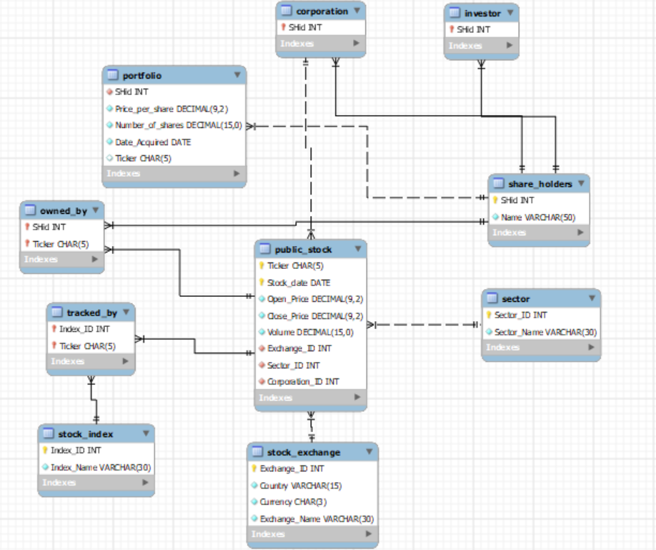
Notes:
1) Project idea
2) User requirements (Basic operations and questions)
3) ERD with Database tables, relationships, constraints etc

Slide 14

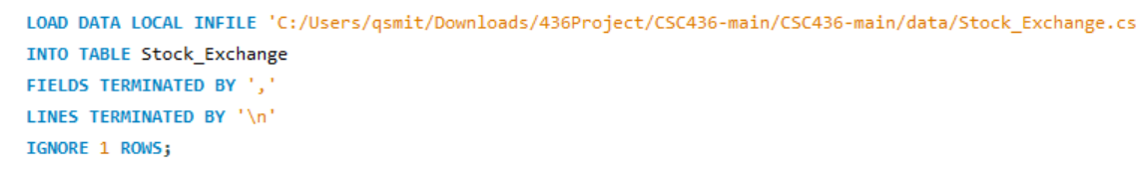
Tools We Used
YFinance (Stock Data real, Portfolio data fake)
Visual Studio Code
Node
React
Notes:
4) Data sources, if exists
8) Description of the Technology used for your interface
Implementation. YFinance is Yahoo Finances API and can be used to comb through their data for information such as stock names, prices, volumes, market cap, and many other data points. Python scripts can pull data from Yahoo into Excel sheets that can then be imported into MYSQL. React is a free and open-source front-end JavaScript library for building user interfaces. In React, applications are developed by creating reusable components. These components are individual pieces of a final interface. When assembled they form the application’s entire user interface.

Slide 15


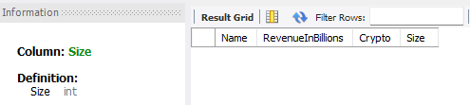
GUI DDL
Create Table
Alter Table Add
Alter Table Modify
Brokerage_Firm | Name varchar(20), RevenueInBillions int, Crypto char
Brokerage_Firm | Size varchar(20)
Brokerage_Firm | Size int
Notes:
5) SQL queries and sample results for each, (cover different types of
queries DDL, DML, DCL,)

Slide 16
GUI DDL
Create Index
fast_brokerage | Brokerage_firm(Name)
Brokerage_view | Name, RevenueInBillions | Brokerage_firm
Notes:
5) SQL queries and sample results for each, (cover different types of
queries DDL, DML, DCL,)

Slide 17
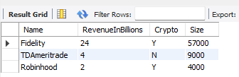
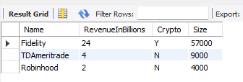
GUI DML
Insert Into Table
Update Table
Brokerage_Firm | Name, RevenueInBillions, Crypto, Size | "Fidelity", 24, 'Y', 57000
Brokerage_Firm | Crypto = 'N' | Name = "Robinhood"
Notes:
5) SQL queries and sample results for each, (cover different types of
queries DDL, DML, DCL,)
"TDAmeritrade", 4, 'N', 9000
"Robinhood", 2, 'Y', 4000

Slide 18
GUI DML
Delete From Table
Brokerage_Firm | Name = “Fidelity”
Notes:
5) SQL queries and sample results for each, (cover different types of
queries DDL, DML, DCL,)
"TDAmeritrade", 4, 'N', 9000
"Robinhood", 2, 'Y', 4000

Slide 19
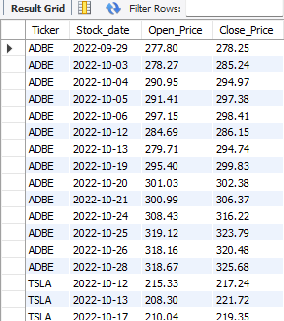
GUI DQL
Select from Table
Ticker, Stock_date, Open_Price, Close_Price | public_stock | Close_Price > 200 and Close_Price > Open_Price;
SHid, Ticker, Number_of_shares | Corporation | NATURAL LEFT JOIN | Portfolio | Ticker IS NOT NULL
Notes:
5) SQL queries and sample results for each, (cover different types of
queries DDL, DML, DCL,)
SELECT SHid, Ticker, Number_of_shares
FROM Corporation NATURAL LEFT JOIN Portfolio
WHERE Ticker IS NOT NULL;

Slide 20
GUI DQL
Select from Table joins and subqueries
Name, Ticker, Sector_Name | Share_Holders | NATURAL JOIN Portfolio LEFT JOIN (SELECT DISTINCT Ticker, Sector_Name FROM Public_Stock LEFT JOIN Sector USING(Sector_ID)) as sub USING(Ticker);
Notes:
5) SQL queries and sample results for each, (cover different types of
queries DDL, DML, DCL,)
SELECT SHid, Ticker, Number_of_shares
FROM Corporation NATURAL LEFT JOIN Portfolio
WHERE Ticker IS NOT NULL;

Slide 21
Questions?

